Slide 1
Assessing Trends of Mother-to-Child Transmission of HIV in Mozambique
Laura Iannopollo
Daudet Tshiswaka, PhD
University of West Florida

Slide 2
Disclosure(s)
I, Laura Iannopollo, have no financial disclosures that would be a potential conflict of interest with this presentation.

Slide 3
Outline
Competencies / SDG / Variables
Background
Public Health Significance
Methodology
Results
Discussion
Limitations
Public Health Lessons Learned
Recommendations / Future Work
ePortfolio Link
Acknowledgements
References

Slide 4
Competencies / SDG / Variables
Program Competencies
C-2. Select quantitative and qualitative data collection methods appropriate for a given public health context.
C-4. Interpret results of data analysis for public health research, policy or practice.
C-7. Assess population needs, assets, and capacities that affect communities’ health.
GH 5. Evaluate barriers to population health services in low- and middle-income countries and the capacity of public health systems for disease surveillance and monitoring.
C-19. Communicate audience-appropriate public health content, both in writing and through oral presentation.
Sustainable Development Goal
SDG 3: Ensure healthy lives and promote well-being for all at all ages.
  Target 3.3 By 2030, end the epidemics of AIDS, tuberculosis, malaria and neglected tropical diseases and combat hepatitis, water-borne diseases and other communicable diseases.
Variables of Interest
Among pregnant women: age, education, marital status, wealth quintile, residence, antenatal care, HIV status (maternal and infant), received antiretroviral therapy, viral load suppression, breastfeeding status, early infant testing.
Notes:
These MPH program competencies were selected to highlight the public health issues surrounding the prevalence of HIV among pregnant and breastfeeding women and the risks of vertical transmission to their children. This project aligns with SDG 3. Although SDG 3 covers a wide range of public health issues, this project specifically pertains to Target 3.3 to end the epidemic of AIDS.

Slide 5
Background
Sub-Saharan Africa accounts for 64.9% of the global population living with HIV.
Mozambique accounts for 9% of those in SSA living with HIV, of whom 62.5% were women (aged 15 and older).
Among all people living with HIV in Mozambique in 2022: 86% knew their HIV status, 93% of those who were HIV-positive received ART, and 88% of those on ART were virally suppressed.
Transmission occurs primarily through heterosexual relations, though other known drivers exist such as harmful gender norm, sexual violence, and mother-to-child transmission (MTCT).
Without appropriate treatment15-30% of exposed infants will acquire HIV during gestation, with a further 5-15% of acquiring HIV through breastfeeding.
Access and utilization of antenatal care (ANC) during pregnancy serves as a critical point of entry to comprehensive maternal and child health services, which include HIV testing services and treatment for prevention of MTCT.
Problem Statement: The substantially high rate of HIV prevalence in Mozambique, especially among women of child-bearing age, leads to high HIV infection among their infants and impacts the overall national HIV/AIDS health burden.
Notes:
Mother-to-child Transmission (MTCT), also referred to as vertical transmission, is the primary mode of transmission among children (ages 0-14). Prevention of MTCT plays a critical role in reducing HIV infections but also aims to improve overall health outcomes for women and children and to reduce the mortality of AIDS.

Slide 6
Background
Four prong strategy for Prevention of MTCT (PMTCT) programs:
Primary prevention of HIV infection in women of reproductive age and their partners.
Prevention of unintended pregnancies among HIV-positive women.
Prevention of HIV transmission from infected mothers to their infants.
Provide supportive care for HIV infected mothers, their infants, and family members.
Elimination of MTCT Targets:
95% of pregnant women attend ANC visit (at least one).
95% of pregnant women tested for HIV.
95% of HIV-positive pregnant women receive antiretroviral therapy (ART).
Key Strategies adopted in Mozambique to improve PMTCT efforts:
Integrated HIV Testing Services (HTS) with first ANC visit.
Endorsed the Global Initiative for the elimination of vertical transmission, aiming to
reduce the transmission rate to ≤ 5% and PMTCT coverage of 90%.
Option B+ strategy recommended by WHO in 2015 was implemented to provide ART to
seropositive pregnant women regardless of their CD4 count and staging.
*World Health Organization recommends a minimum of 8
ANC visits to improve maternal and child health outcomes.
Notes:
Mother-to-Child Transmission (MTCT) may also be referred to as vertical transmission. Vertical transmission is the preferred phrase to avoid language that centralizes the mother to HIV transmission and to reduce stigma felt by women living with HIV (WHO, 2022). Women in Mozambique often under-utilize antenatal care (ANC)

Slide 7
Background
Disproportionate burden of HIV among women has a complex set of socioeconomical factors that make risk reduction efforts challenging.
Challenges in Mozambique
Human Development Index (HDI) ranked 183 out of 193 countries and territories (UNDP, 2022).
Gender Inequality Index (GII) ranked 118 out of 166 countries (UNDP, 2022).
In 2022, approximately 60% of the population lived in extreme poverty per capita gross national income of USD 420. (WFP, 2022).
Since 2015, economic downturn, with steep decline in foreign direct investment (Reports indicate the country utilizes ≥ 95% of foreign aid towards PMTCT) (WFP, 2022).
Since 2017, armed conflict in Cabo Delgado- Mozambique’s poorest province in terms of Multidimensional Poverty- escalated rapidly, compounding existing vulnerabilities (WFP, 2022).
In 2020, the cascading impacts of COVID-19 caused the economy to contract by a further 1.3 percent, resulting in an estimated 2 million people entering poverty (WFP, 2022).
Food insecurity is a risk factor for HIV infection and a critical barrier to adherence to ART and retention in care (WFP, 2022).
Prevalent discriminatory cultural norms, limited public resources, policy gaps, and a shortage of data impedes the effective inclusion of people with disabilities and the safeguarding of human rights (WFP, 2022).
Notes:
Human Development Index: used to measure and rank countries based on their achievements in 3 key dimensions- long healthy life, education, and standard of living.
Gender Inequality Index: also used to measure and rank countries on achievements in 3 key dimensions- reproductive health, empowerment, and economic activity.

Slide 8
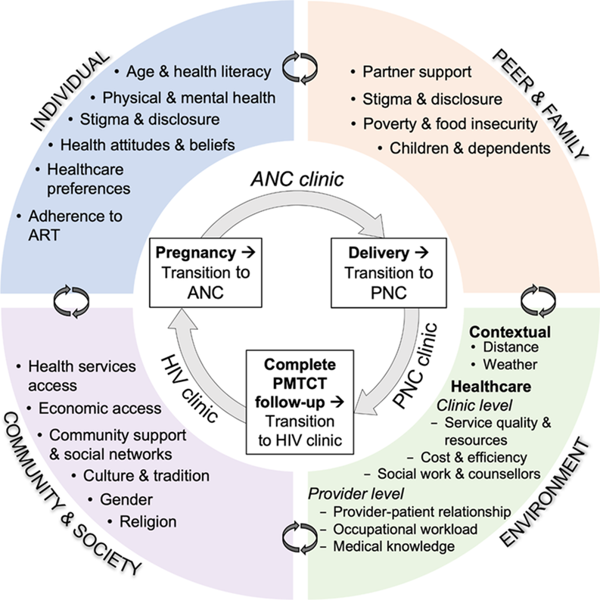
Public Health Significance
Mozambique is one of the poorest countries in the world, where women are especially vulnerable to gender-based discrimination, stigma, sexual violence, socially constructed gender differences (e.g. roles and responsibilities, access to resources, decision-making power) and economic hardship that contribute to high prevalence of HIV.
Other contributing factors:
Individual sociocultural attributes
Inadequate health infrastructure
Inadequate skilled human resources
Age
Education
Employment
Importance:
Continuous monitoring of PMTCT programs and EMTCT indicators is critical to providing cost-effective strategies, policy change, and ethical guided responses.
Figure 1. Socio-ecological model of retention in care throughout the PMTCT
continuum. Data Source: Humphrey, J., et al (2021).

Slide 9
Methodology
Secondary data analysis using the Population-based HIV Impact Assessment (PHIA) Mozambique from 2021.
Nationally representative, multi-stage household-based survey to measure the impact of the country’s HIV response.
Led by Mozambique’s Ministry of Health with support from the U.S, President’s Emergency Plan for AIDS Relief (PEPFAR) through the U.S. Centers for Disease Control and Prevention (CDC), and ICAP at Columbia University.
Adults (aged 15 and older) eligible to participate.
Consent provided for interview, home-based HIV testing and counseling, and collection of blood samples for home- and laboratory-based testing.
Among the adult population surveyed, 13.1% (n=2,237) were women who gave birth during the 3 years preceding the survey.
Women who reported giving birth prior to January 1, 2018 or reported no live births were not include in this study.
After exclusion of missing values, the total sample size of this study was 2,065.
IRB approval not required
Notes:
(ICAP is not an acronym)

Slide 10
Methodology
Variables in Dataset:
Infant HIV status- outcome.
Attended ANC (at least one).
HIV status while pregnant.
Received ART while pregnant.
Viral Load Suppression.
Breastfeeding Status.
Early Infant Testing.
Age.
Education.
Marital Status.
Wealth Quintile.
Residence.
IBM SPSS standard 30 statistical software was used to perform descriptive statistics.
Primary focus was to assess EMTCT target indicators among women (aged 15-49 years) who had given birth to their last infant (between January 1, 2018 and January 1, 2021).

Slide 11
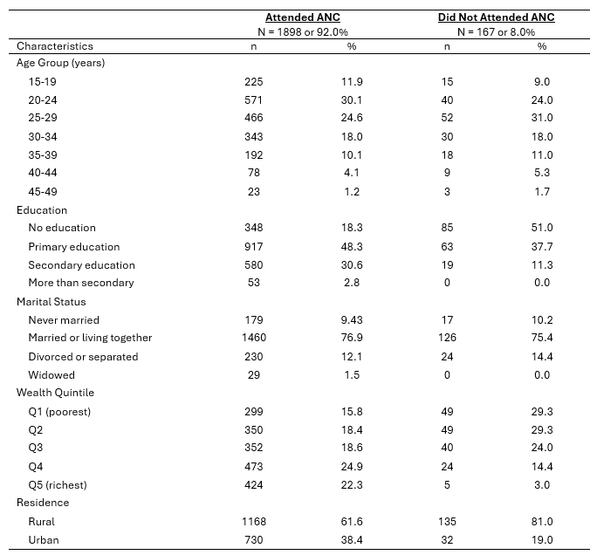
Results
Table 1. Descriptive characteristics among mothers with reported ANC coverage.

Slide 12
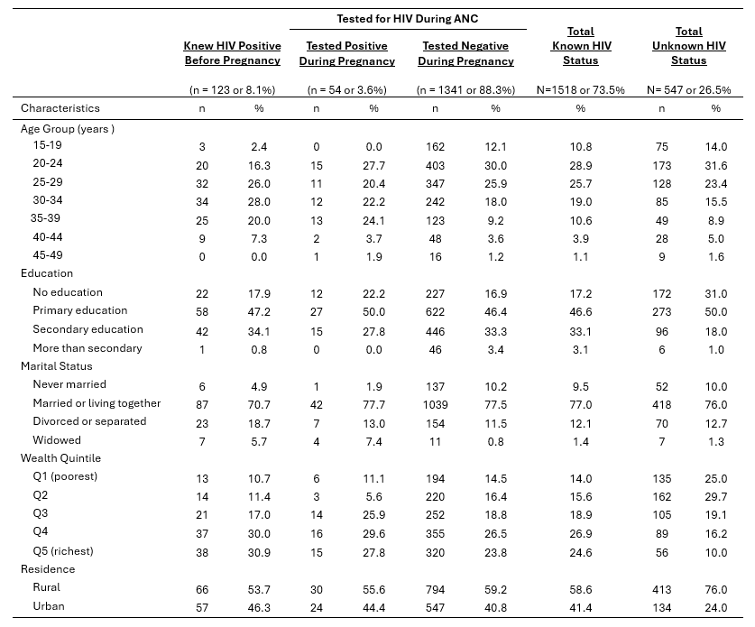
Results
Table 2. Descriptive characteristics among mothers with known HIV status.
Notes:
Data highlighted with yellow on chart are utilized to in Figure 2 to visually demonstrate the percentage of women’s reported HIV status

Slide 13
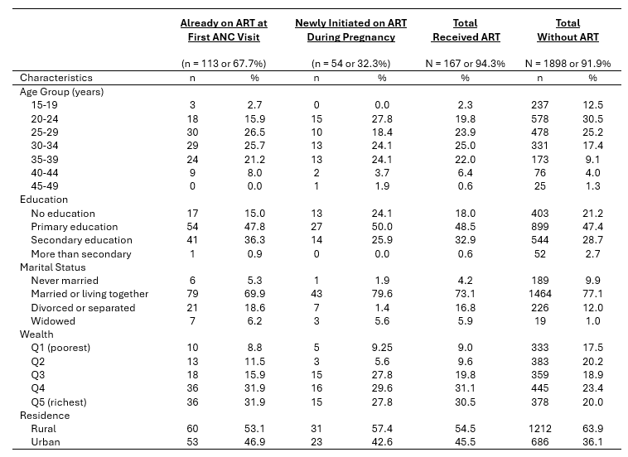
Results
Table 3. Descriptive characteristics among mothers with ART coverage.
Notes:
Data highlighted on chart are represented in Figure 2 to visually demonstrate the percentage of women with reported ART use. Of importance, the Total Without ART also includes women who reported as HIV negative. From Table 2, there were a total of 177 women who were reported to be HIV positive.

Slide 14
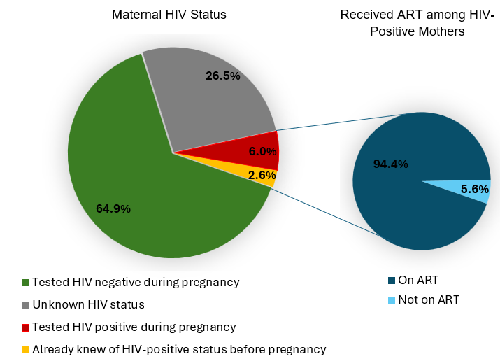
Results
Figure 2. Reported HIV status and ART usage among HIV-positive mothers
Notes:
Refer to Table 2 and 3 for further details.

Slide 15
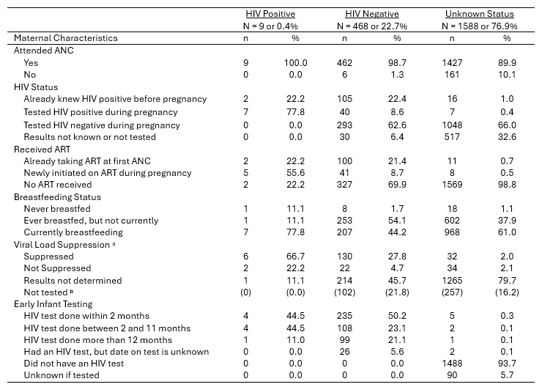
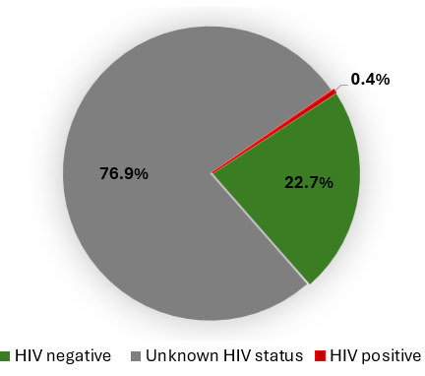
Results
Table 4. Descriptive characteristics of maternal health behaviors among HIV exposed infants
ª Timeframe on achieved viral suppression correlated to intrauterine or postpartum characteristics not indicated.
^{b} Data for infant HIV status associated with non-consent for maternal HIV virological testing.

Slide 16
Discussion
Elimination of Mother-to-Child Transmission (EMTCT) Programmatic Target
First 95 Target: 92% of pregnant women attended ANC visit (at least one).
Second 95 Target: 73.5% of pregnant women knew their HIV status.
a) 11.7% were HIV-positive during pregnancy.
    8.1% knew they were HIV positive before pregnancy.
    3.6% tested positive during pregnancy.
b) 88.3% were HIV negative during pregnancy.
c) 26.5% did not know their HIV status.
Third 95 Target: 94.3% of HIV-positive women received ART.
Infant HIV Status- Outcome
23.1% of infants had a known HIV status, of whom 0.4% (n=9) were HIV positive.

Slide 17
Limitations
Inability to establish a cause-and-effect relationship
Data does not provide for in-depth analysis of relationships between time-related factors (e.g. timing of first ANC visit, HIV test, ART initiation, or viral suppression) impacting infant HIV status.
Non-responses for participation in the survey or non-consents to blood testing at the time of the survey which may be associated with HIV status potentially skew data.

Slide 18
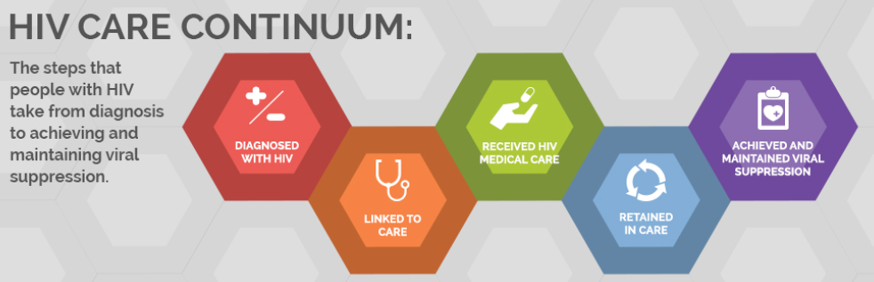
Public Health Lessons Learned
The complex, multifaceted interaction between maternal health behaviors, cultural beliefs and attitudes, and socioeconomic status, and access to quality health services significantly influences MTCT transmission rates.
Barriers to care and loss to follow up at ANC services translates into lost opportunities for counseling, testing and retesting, and treatment.

Slide 19
Recommendations/Future Work
Improve retention in care and adherence to ART among HIV-positive pregnant and breastfeeding women.
  Promote early access to ANC visits and increased frequency of ANC.
  Improve access to quality health services for increased HIV-testing and ART adherence.
  Increase skilled health services to improve early infant testing, early prophylaxis, and HIV retesting post-breastfeeding.

Slide 20

ePortfolio Link
https://www.lauraiannopollo.com/

Slide 21
Reference

Slide 22
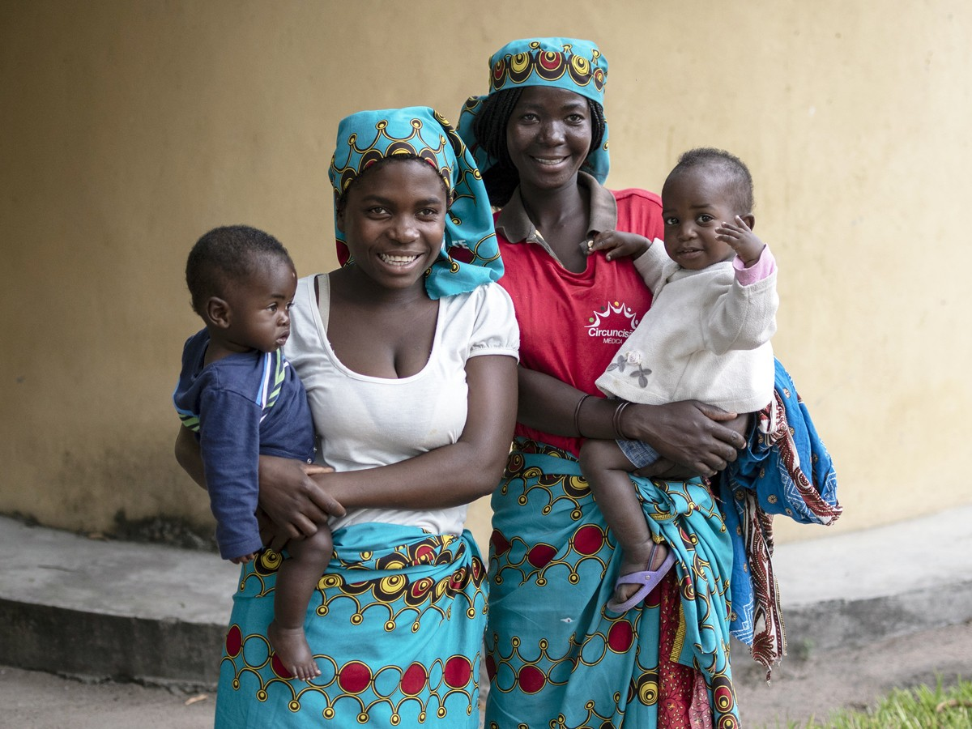
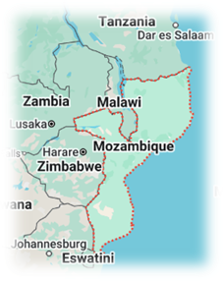
Questions?

